Slide 1
FY22 Civil Rights Compliance Training for FDC Providers
Child and Adult Care Food Program (CACFP)
Notes:
Hello and welcome to the fiscal year 2022 Civil Rights training for USDA child nutrition programs, including the Child and Adult Care Food Program. This training is designed to keep you up to date on the Federal Civil Rights requirements for the current program year.
This training is designed for Family Day Care Home providers.

Slide 2
Purpose of today’s training
By the end of today you will:
Understand the basics of Civil Rights compliance for Family Day Care Home providers in the Child and Adult Food Program (CACFP).
Complete your required annual training for Civil Rights Compliance.
Notes:
The purpose of this training is to educate Massachusetts Family Day Care Home providers on the federal Civil Rights requirements that they must adhere to as part of the Child and Adult Care Food Program (also known as CACFP).
This training is an annual requirement and is monitored by your Sponsoring Organization.

Slide 3
CONTENTS
01
Introduction to Civil Rights
02
Reasonable modifications
03
Limited English Proficiency (LEP)
04
Customer service and conflict resolution
05
Complaints of discrimination
06
Compliance reviews and Civil Rights training
07
Nondiscrimination statement
Notes:
This slide provides you with a brief outline of what we will be discussing during today’s presentation.
We will start with an introduction to Civil Rights, and then address several components of adhering to Civil Rights requirements, including:
Making reasonable modifications for participants with disabilities
Providing language assistance for individuals with limited English proficiency
Providing customer service and resolving conflicts in your program
Process and procedures for filing Civil Rights complaints
Civil Rights compliance reviews and Civil Rights training requirements, and finally
The current USDA nondiscrimination statement

Slide 4
Introduction to Civil Rights
01
Notes:
Let’s begin with an introduction to Civil Rights.
In this section we will cover the USDA requirements on Civil Rights adherence, what discrimination means, and who is protected under the nondiscrimination policy.

Slide 5
Federal funds and Civil Rights
FNS Instruction 113-1
The United States Department of Agriculture (USDA) prohibits discrimination in all its programs and activities.
As part of your CACFP contract, you must assure the Sponsoring Organization that you will adhere to all Civil Rights requirements.
Notes:
The USDA prohibits discrimination in all of its programs and activities, which includes CACFP. This means that the USDA must ensure that public funds are not spent in a way which encourages, subsidizes, or results in discrimination.
Therefore, if you are receiving federal funds through CACFP you need to assure that your organization is meeting all Civil Rights requirements. This is part of the contract you sign when you become a CACFP Family Day Care provider.

Slide 6
Civil Rights and discrimination
Civil Rights
Discrimination
The right to freedom from discrimination
The act of distinguishing one person or group of persons from others, either intentionally, by neglect, or by the effect of actions or lack of actions based on their protected classes.
Notes:
So, what exactly are Civil Rights? Civil Rights are the right to freedom from discrimination.
Discrimination is defined as, “the act of distinguishing one person or group of persons from others, either intentionally, by neglect, or by the effect of actions or lack of actions based on their protected classes.”

Slide 7
Protected classes
Nationally (FNS 113-1):
Massachusetts
Race
Color
National Origin
Age
Sex
Disability
ALL federal groups, plus:
Religion
Gender identity
Sexual orientation
Notes:
The definition of discrimination from the previous slide included the phrase “protected classes”. So what are protected classes? A protected class is any person, or group of people, who have characteristics for which discrimination is prohibited.
National policy identifies six protected classes; these classes are race, color, national origin, age, sex, and disability. In addition to the six national classes, Massachusetts has three additional protected classes which are Religion, gender identity, and sexual orientation.
USDA programs must be delivered equitably to all people. Program providers must be made aware of the protected classes and their Civil Rights responsibilities in your organization and in the operation of CACFP.

Slide 8
Reasonable modifications
02
Notes:
In that first section we addressed what Civil Rights are, and who is protected from discrimination. In this section, we will discuss how programs are expected to make reasonable modifications to their program sites in order to meet the needs of program participants who may be part of a protected class.

Slide 9
Reasonable modifications: disabilities
Homes are required to make substitutions to meals for participants with a disability, when the disability restricts their diet.
Food choice alternatives for allergies
Altering the consistency of a food item
Meal service support
Notes:
In our discussion of protected classes we saw that one nationally-protected class is individuals with a disability.
As an individual’s disability may impact their diet or nutritional needs, the USDA requires that program operators make reasonable modifications to the meal, including providing special meals at no additional cost, to accommodate someone with a disability. Meal modifications may include offering an alternative to a food that a child is allergic to, altering the consistency of a food component to facilitate feeding, or supporting the child during the meal service so they may participate in the meal.

Slide 10
Defining disability
FNS language on disability definition: (CACFP14-2017/SFSP 10-2017)
Reducing burden on disabled person to prove disability, program operator from having to determine disability
Expanded and clarified definition of disability:
physical or mental impairment which limits one or more “major life activity”
eating & digestion
Notes:
This requirement to accommodate disabilities is a longstanding policy from the USDA. However, there has been a change to the way this is implemented; in June 2017, the USDA released a memo which broadened the definition of a disability. The purpose of this was twofold: first, to eliminate the burden on the disabled person from having to “prove” their disability; secondly, to ease the burden on program operators, so they are not responsible deciding what constitutes a disability.
This memo, which is linked here in the slide, states that:
“A disability is defined as a mental or physical impairment which limits one or more “major life activity”– [the impairment] does not need to be life threatening to constitute a disability.”
Under this definition, eating and digestion are considered major life activities, and therefore an impairment to eating or digestion could be considered a disability. That means that food allergies, such as lactose intolerance, may be considered disabilities and must be accommodated for when a written statement is provided stating that the participant has a disability.
This is different from previous years where a food intolerance, such as lactose intolerance, was not considered a disability but a “medical condition” and program operators were encouraged, but not required, to make a substitution even with a medical statement on file.

Slide 11
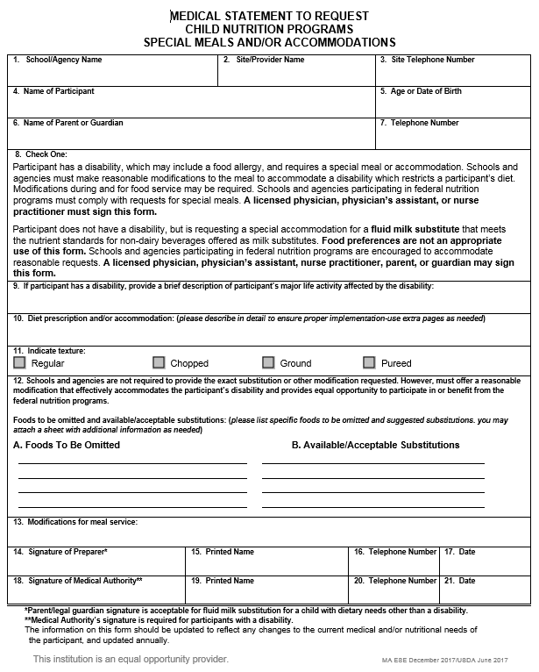
Medical Statement to Request Special Meals and/or Accommodations in Child Nutrition Programs
The updated medical statement form is available from your sponsor
Updated language on disability, to include food allergies
Added specific language to acceptable substitutions
Medical authority signature
Notes:
To document a disability, a child must have a completed and signed “Medical Statement to Request Special Meals and/or Accommodations in Child Nutrition Programs” form, which is available from your sponsoring agency.
This form has recently been updated to address the changes we just discussed.
The changes to this Medical Statement form include:
Updated language on what constitutes a disability to include food allergies
Details on what sponsors are required to do, including making a reasonable modification to meet the needs of the individual, but they are not required to serve the exact request
Change in language from requiring a physician signature to a medical authority signature. A medical authority includes physician’s assistants and nurse practitioners or anyone else eligible to write medical prescriptions under state law

Slide 12
Accommodating a disability and meeting the meal pattern
You can often accommodate a disability while remaining within the meal pattern.
OR
Meals that do not meet meal pattern must be supported by medical statement to be eligible for reimbursement.
Notes:
If a participant has a disability, it’s sometimes possible to accommodate this disability while staying within the meal pattern. For example, if an individual were allergic to apples, and that was part of the posted snack item at your program that day, instead of an apple you could offer an orange or another fruit or vegetable. This way, the disability is accommodated for, and the snack still meets the meal pattern for a reimbursable meal.
However, if it is not possible for a meal or snack to meet the meal pattern because of a disability, a medical statement MUST be on file in order for you to be reimbursed for that meal.
If a disability impacts the ability to adhere to the meal pattern, the disability must be supported by a written statement from a licensed healthcare professional in order for that meal to be reimbursable.

Slide 13
Limited English Proficiency (LEP)
03
Notes:
Language is also an important part of program accessibility. We will now briefly touch on how to ensure that your program is taking the necessary steps to support individuals with Limited English Proficiency, or LEP.

Slide 14
Limited English Proficiency (LEP): language assistance
Language barriers and Limited English Proficiency (LEP) as a source of program discrimination
Providers are responsible to take reasonable steps to ensure access to their programs and activities by persons with Limited English proficiency (LEP).
Providers should work with their Sponsoring Organization to ensure access to language assistance services for persons with LEP (when necessary).
Notes:
Next, we are going to discuss another part of your program which may require reasonable accommodations. Language or communication barriers may be considered potentially discriminatory actions. CACFP program operators are required to take reasonable steps to ensure access to their programs by individuals with limited English proficiency or LEP.
For Family Day Care Providers, they should work with their Sponsoring Organization to identifying when access to language assistance for LEP persons is necessary and what reasonable steps must be taken.

Slide 15
Language assistance- reasonable steps
What are “reasonable steps”?
Number or proportion of LEP persons eligible to be served, or likely to be encountered
How many LEP people do you encounter in your general eligible population?
How many LEP people are likely to be encountered within your program’s service area?
Frequency of contact with the program
How often do LEP individuals come in contact with your program?
Nature of the program
What type of program are you providing?
Resources available
What resources are available to the individual, and what would be the cost to make more available?
Resources may include: interpretive services, translation capabilities for documents
Notes:
Providers should work with their Sponsoring Organization to take reasonable steps towards ensuring access to their program for persons with LEP.
What are considered reasonable steps? There are four main questions to consider when determining what is “reasonable” for your program:
Numbers: How many individuals (or what proportion of individuals) with limited English proficiency do you encounter in your general eligible population for the program? How many individuals are likely to be encountered within your program’s service area that are LEP?
Frequency: How often do you come into contact with individuals with limited English proficiency?
Nature of program: What is the nature of your program, and how important is it?
Available resources: What resources are available to the recipient, and what would it cost to make resources available?

Slide 16
Customer service and conflict resolution
04
Notes:
Next, let’s talk about the providing quality customer service for all individuals who come into contact with the CACFP.

Slide 17
Customer Service
Good customer service reduces the chance of receiving discrimination complaints
In all aspects of your programming, be courteous and thoughtful
Be polite and patient with participants and guardians.
Listen and ask questions.
Be empathetic.
Train staff on customer service and conflict resolution.
Notes:
Providing quality customer service reduces or eliminates the chances of receiving a discrimination complaint. In all aspects of your programming, be courteous and thoughtful to participants and their families or guardians. This includes being polite and patient with individuals as they may ask you many questions about how the program works and what is available to them. Allow them to ask questions, and listen to their concerns.
When possible, be empathetic to their needs. Sometimes it is hard to understand that people may not know the rules or understand how these programs work. Individuals may feel uncomfortable in asking questions or asking for help.
Organizations that provide training on customer service and conflict resolution are more sensitive to Civil Rights issues and compliance.

Slide 18
Complaints of discrimination
05
Notes:
Next, let’s talk about the process for receiving or filing a compliant related to Civil Rights.

Slide 19
Civil rights complaints: filing facts
Filing facts
Individuals have a right to file a complaint
Never discourage complaint filing
Complaints can be verbal or written
Form or letter (USDA letter requirements)
Complaints must be made within 180 days of alleged action
Public posting of complaint filing process is part of the required public notification system
Notes:
As we just mentioned, providing quality customer service can help reduce the chance of receiving a civil rights complaint; however, if a participant, potentially eligible person, or any individual who comes into contact with the CACFP program feels that their civil rights have been violated in any way, they have the right to file a civil rights complaint. You should never discourage an individual from filing a complaint.
Discrimination complaints can be made either verbally or in writing. On the USDA civil rights website, which is linked on this slide, there is an outline what information must be included in a complaint letter. If an individual would rather complete a complaint form than file a letter, they can contact the email address listed on that website to receive a copy of the form. Regardless of which format they choose to use complaints must be filed within 180 days of the alleged discrimination action. This is roughly just under 6 months’ time.
There are two main resources you should direct individuals to when they would like to file a complaint.
First, you should provide a copy of the non-discrimination statement
Second, you should provide them with the link to the USDA civil rights webpage and show them the instructions on how to request a complaint form and/or submit a letter.
Let them know that the USDA website contains all the instructions on how to file a complaint and includes sources of support that they can access for free.

Slide 20
Civil rights complaints: Federal vs. State process
Filing a complaint for violation against a federally protected class
Filing a complaint for violation against a state protected class
A complaint citing a Federal protected class (race, color, national origin, sex, disability, and/or age), must be submitted directly through the USDA Food and Nutrition Service (FNS)
A complaint citing any State protected classes (religion, gender identity, sexual orientation), can be submitted to the MA DESE Problem Resolution System Office
All civil rights complaints received at MA ESE will be logged and forwarded to USDA
Notes:
The type of complaint made will determine whether it is processed by the state agency or if it goes directly to the USDA. If an individual is filing a complaint citing discrimination against a FEDERALLY protected class, which include– race, color, national origin, sex, disability, and/or age– then this complaint must be filed directly with the USDA Food and Nutrition Services.
If an individual is filing a complaint citing discrimination against a STATE protected class, which include– religion, gender identity, and/or sexual orientation– then this complaint would be filed with the MA ESE Problem Resolution System Office. Please note that all civil right complaints received by the MA DESE, regardless of impacted affected class, will be logged and forwarded to the USDA.

Slide 21
How to file a Civil Rights complaint
Federal complaint filing
State complaint filing
USDA Nondiscrimination statement
USDA Civil Rights website includes instructions for filing including how to access a complaint form, and resources for individuals who may need assistance.
USDA Nondiscrimination statement
MA DESE OFNP Civil Rights website includes instructions for filing including how to access a complaint form, and resources for individuals who may need assistance.
Notes:
When filing a complaint either directly with the USDA or with MA DESE, there are a few important things to know.
First, regardless of filing a Federal or State complaint, you should provide the individual with a copy of the non-discrimination statement (linked here from the ESE website).
Next, discrimination complaints can be made either verbally or in writing. On the USDA Civil Rights website, which is linked on the left side of this slide, there is an outline what information must be included in a complaint letter. If an individual would rather complete a complaint form than file a letter, they can contact the email address listed on that website to receive a copy of the form. Individuals may send their complaint in via email or traditional mail.
If an individual if filing a complaint with MA DESE, the Civil Rights website (which is linked on the right hand side of this slide) provides the address to which complaints can be sent. Again, individuals may send their complaint in via email or traditional mail.
Both of these websites provide resources for individuals with language proficiency limitations, or other disabilities which impact their communication of program information.
Again, regardless of which format they choose to use, or to which agency they’re sending their complaint, the complaint must be filed within 180 days of the alleged discrimination action.

Slide 22
Handling complaints: conflict resolution
Individuals have a right to file a complaint
Refer to your organization’s handbook for your written policies on non-discrimination.
In any conflict get help, especially if there are threats or if violence is possible
Notes:
We understand that receiving a complaint can be a stressful or confusing time for a provider. If you have received notice that someone connected to your program feels their Civil Rights have been violated, it is important to know how to respond:
First, remember that any individual who comes into contact with your CACFP program has a right to file a complaint.
In any conflict situation, make sure to get help; this is especially important if there are threats made or if violence is possible
When appropriate, refer participants and their families to your handbook so they may see your written policies on non-discrimination.

Slide 23
Compliance review and Civil Rights training
06
Notes:
Now let’s discuss about the compliance review process.

Slide 24
Civil Rights compliance review
As part of the monitoring and review process, providers will have their compliance with Civil Rights requirements assessed
Monitors will review program operations and ask questions specific to program operations and policies
Monitors will also complete an observation during a meal service to collect data for a Sponsor Civil Rights document
Notes:
Even without any Civil Rights complaints, providers must have their Civil Rights compliance assessed. This occurs during the regular review process, and is referred to as a compliance review.
FDC Monitors will conduct a Civil Rights compliance review as part of the CACFP program monitoring.
During this compliance assessment, FDC monitors will review program operations and may ask providers questions about program access and policies. In addition, monitors will complete a meal service observation form.

Slide 25
Civil Rights data collection process
Data collection process
What data are collected
Based on visual observation, children should NEVER be asked
Can open this discussion about data collection requirement, and use of information with parents or guardians during application
Ethnicity (you have only one)
Hispanic/Latino OR Non-Hispanic/Latino
Race (you can have multiple)
Black/African American
American Indian or Alaska Native
Native Hawaiian or other pacific islander
Asian
White
Notes:
The process of completing these forms is straight forward; the monitor will be visually observing children during a meal service and determining the ethnicity and race of each child.

Slide 26
Nondiscrimination statement
07
Notes:
Now let’s talk about the nondiscrimination statement. This statement is from the USDA and is modified regularly to reflect the most current policy and information.

Slide 27
Current USDA nondiscrimination statement for printed documents
In accordance with Federal civil rights law and U.S. Department of Agriculture (USDA) civil rights regulations and policies, the USDA, its Agencies, offices, and employees, and institutions participating in or administering USDA programs are prohibited from discriminating based on race, color, national origin, sex, disability, age, or reprisal or retaliation for prior civil rights activity in any program or activity conducted or funded by USDA.
Persons with disabilities who require alternative means of communication for program information (e.g. Braille, large print, audiotape, American Sign Language, etc.), should contact the Agency (State or local) where they applied for benefits. Individuals who are deaf, hard of hearing or have speech disabilities may contact USDA through the Federal Relay Service at (800) 877-8339. Additionally, program information may be made available in languages other than English.
To file a program complaint of discrimination, complete the USDA Program Discrimination Complaint Form, (AD-3027) found online at: https://www.usda.gov/oascr/how-to-file-a-program-discrimination-complaint, and at any USDA office, or write a letter addressed to USDA and provide in the letter all of the information requested in the form. To request a copy of the complaint form, call (866) 632-9992. Submit your completed form or letter to USDA by:
(1) mail: U.S. Department of Agriculture
Office of the Assistant Secretary for Civil Rights
1400 Independence Avenue, SW
Washington, D.C. 20250-9410;
(2) fax: (202) 690-7442; or
(3) email: program.intake@usda.gov.
This institution is an equal opportunity provider.
Notes:
This is the current USDA nondiscrimination statement; all of your program documents should include this year’s statement on any items that will be printed so that it is considered up-to-date.

Slide 28
Current USDA nondiscrimination statement for digital documents
In accordance with Federal civil rights law and U.S. Department of Agriculture (USDA) civil rights regulations and policies, the USDA, its Agencies, offices, and employees, and institutions participating in or administering USDA programs are prohibited from discriminating based on race, color, national origin, sex, disability, age, or reprisal or retaliation for prior civil rights activity in any program or activity conducted or funded by USDA.
Persons with disabilities who require alternative means of communication for program information (e.g. Braille, large print, audiotape, American Sign Language, etc.), should contact the Agency (State or local) where they applied for benefits. Individuals who are deaf, hard of hearing or have speech disabilities may contact USDA through the Federal Relay Service at (800) 877-8339. Additionally, program information may be made available in languages other than English.
To file a program complaint of discrimination, complete the USDA Program Discrimination Complaint Form, (AD-3027) found online at: How to File a Complaint, and at any USDA office, or write a letter addressed to USDA and provide in the letter all of the information requested in the form. To request a copy of the complaint form, call (866) 632-9992. Submit your completed form or letter to USDA by:
(1) mail: U.S. Department of Agriculture
Office of the Assistant Secretary for Civil Rights
1400 Independence Avenue, SW
Washington, D.C. 20250-9410;
(2) fax: (202) 690-7442; or
(3) email: program.intake@usda.gov.
This institution is an equal opportunity provider.
Notes:
This is the current USDA nondiscrimination statement; all of your program documents should include this year’s statement on any items that will be available electronically so that it is considered up-to-date.

Slide 29
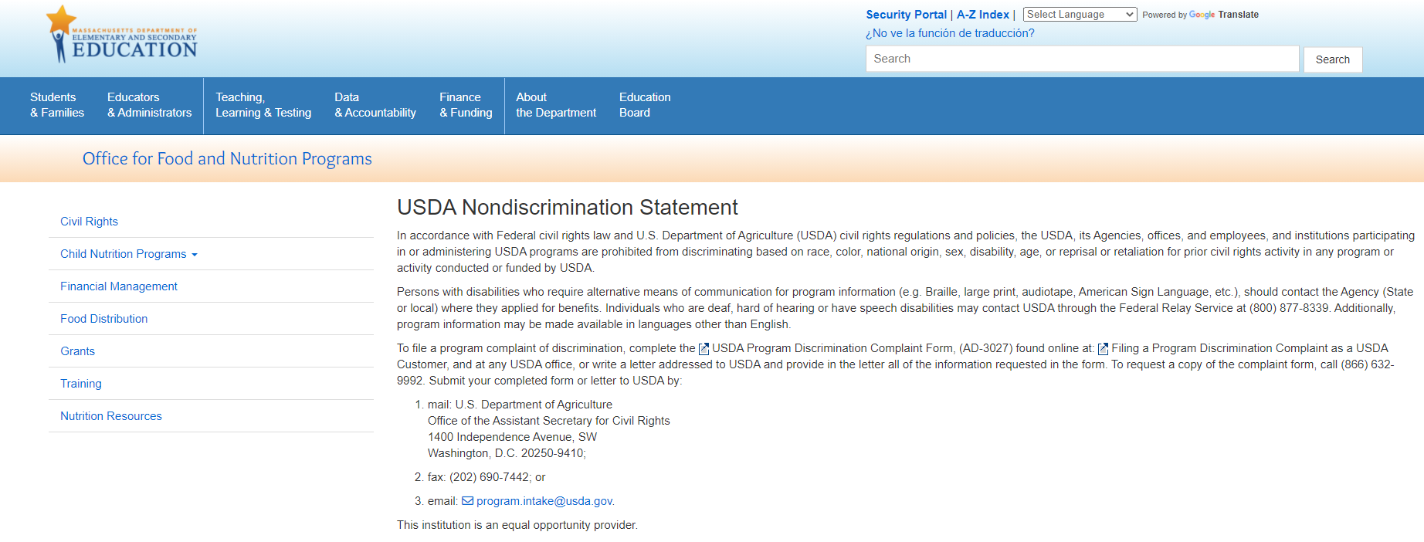
Nondiscrimination statement and your website
Include the full USDA nondiscrimination statement on all vital documents and information produced for the public, including program home and sub-recipient web pages
A direct hyperlink to the digital nondiscrimination statement (not short statement) may be used on web pages
The short nondiscrimination statement may not be used on vital documents
Notes:
As a provider, you must link or post the full USDA nondiscrimination statement on all vital documents and information produced for the public, including program home web pages, and subrecipient webpages.
A direct hyperlink to the full statement may be used on web pages

Slide 30
Nondiscrimination statement and your program documents
For all program documents that mention the CACFP:
The nondiscrimination statement must be in the same size and font as the smallest font on the document.
Formatting of the statement may not be changed.
Exception: “This institution is an equal opportunity provider.”
Notes:
In addition to your website, review all of your organization's documents to identify those that mention CACFP. Include the CACFP Nondiscrimination statement on documents that mention CACFP in at least the same size font as the smallest font on the document.
So, for example, you have a flyer advertising the CACFP program and some of the text is size 18 font and some of the text is size 11 font. You will need to put the nondiscrimination statement on the flyer at a minimum of size 11 font. If you have questions about specific documents, please contact your Sponsoring Agency. By putting this information on your CACFP documents it gives participants the information on how to file a complaint if they are too intimidated to ask someone in your organization. Please also note that the formatting of this statement may not be changed but if the full statement does not seem practical to add to a smaller item like a magnet or pen, you can use the shortened version of this statement “This institution is an equal opportunity provider”.

Slide 31
Building for the Future
Building for the Future Flyer
This flyer should be posted in homes where families can see
Building for the Future pamphlets should be included with the enrollment form for new children
Notes:
Providers should post the Building for the Future flyer (this is the newest version from USDA) in their homes where it is easily accessible to parents and families (such as a bulletin board or parent board).
In addition, the Building for the Future pamphlet should be included with the enrollment form for all new child enrollments.

Slide 32
THANK YOU
www.doe.mass.edu
75 Pleasant Street, Malden, MA 02148
Notes:
If you have questions about this presentation, please do not hesitate to reach out to your Sponsoring Organization.

Slide 33
References
Child and Adult Care Food Program (CACFP) Training Resources. Office of the State Superintendent of Education, DC.Gov

